Slide 1
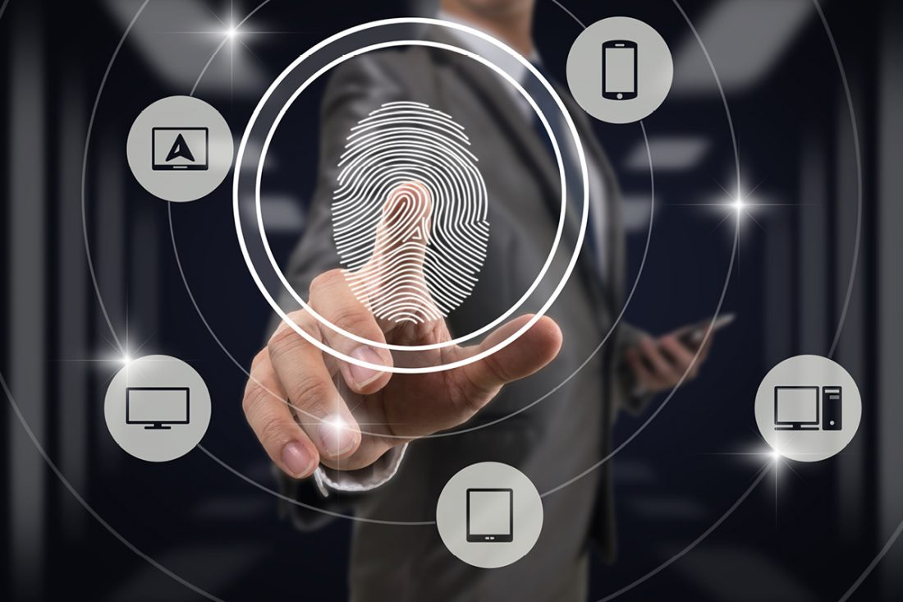
Identity management
Module 2
SoftUni Team
Technical Trainers
Software University
http://softuni.bg

Slide 2
Questions
sli.do # SaaS-Security

Slide 3
Table of Contents
General principles
Security considerations and mechanisms to protect
Creating identities in the cloud
Demonstration

Slide 4
General principles

Slide 5
User accounts
Office/Microsoft 365 cloud services are consumed by users
Users need user accounts
User accounts need to be licensed in order to use the services
Licensing is usually per user, per month

Slide 6
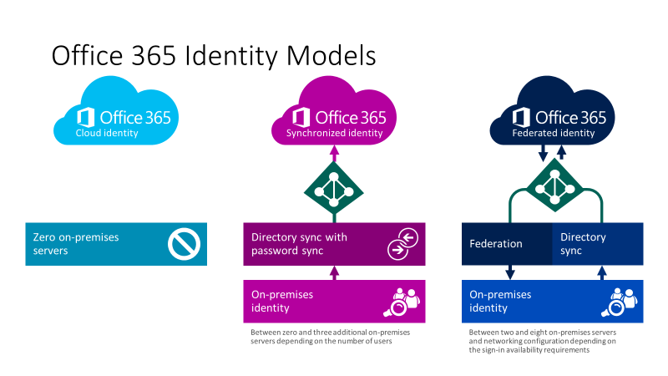
User account types
Cloud identities
Synchronized identities
Federated identities
Notes:
https://www.microsoft.com/en-us/microsoft-365/blog/2014/05/13/choosing-a-sign-in-model-for-office-365/

Slide 7
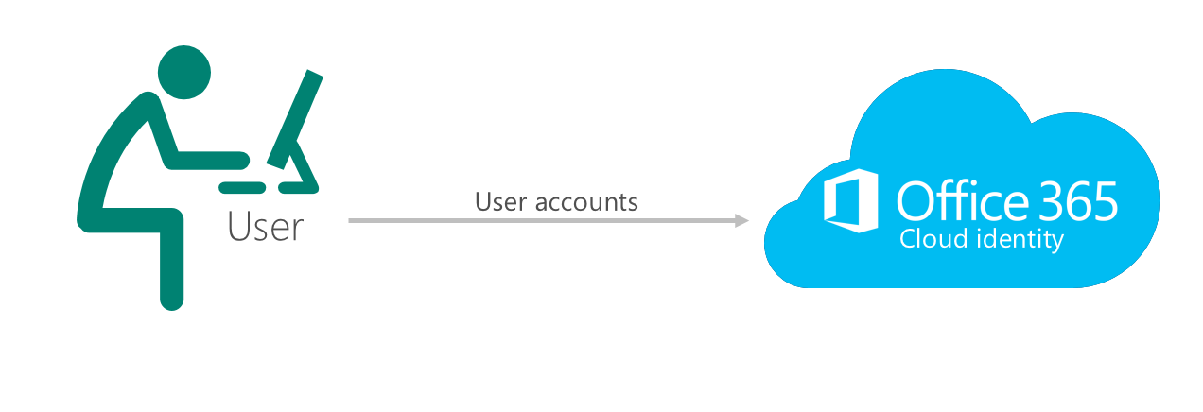
Cloud-only identities
Users are created and managed in Office 365 (Azure AD)
The passwords are verified by Azure AD

Slide 8
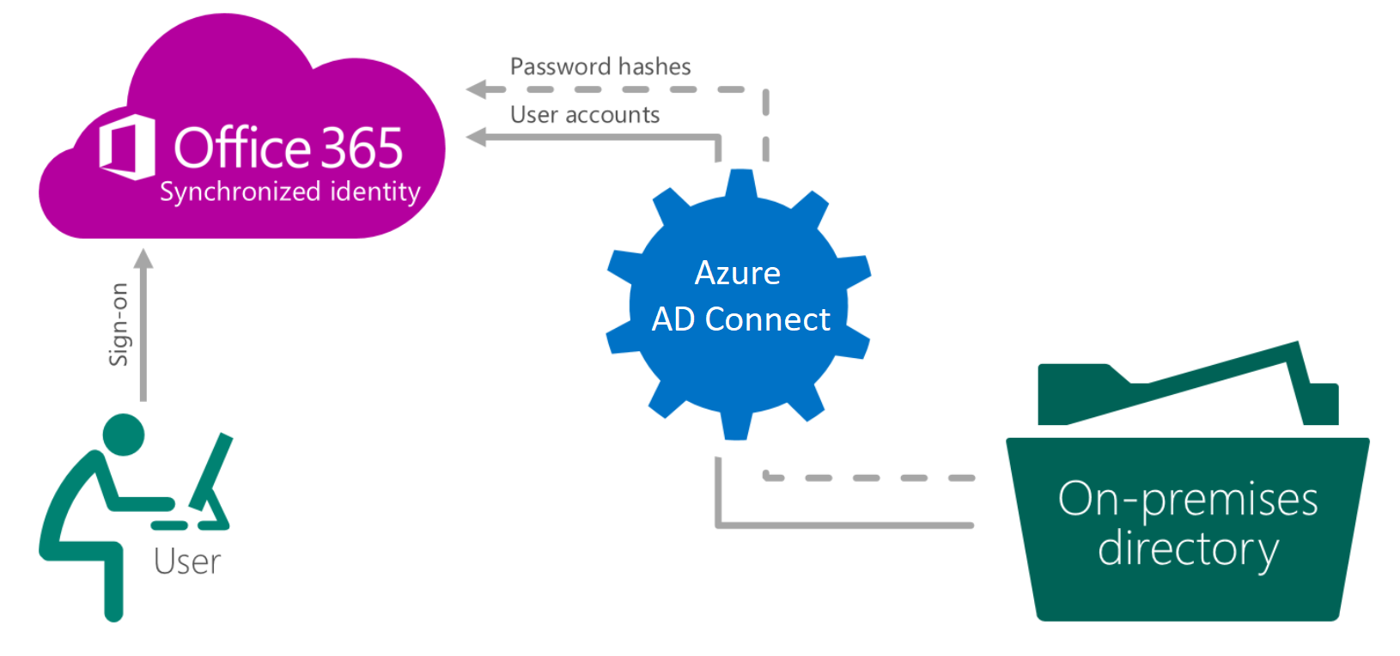
Synchronized identities
Users are created and managed on-premises, then synced to Azure AD (with the passwords hashes)
The passwords are verified by Azure AD

Slide 9
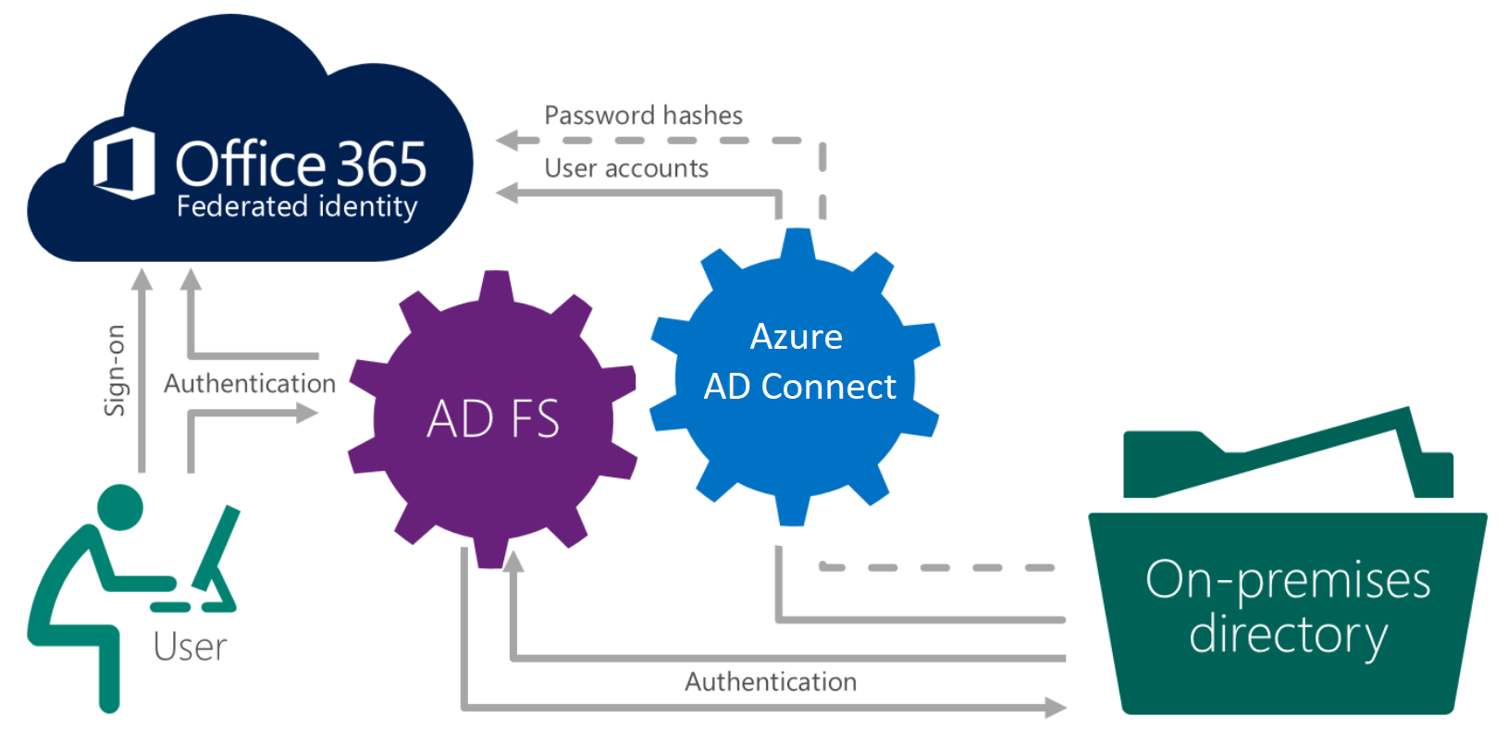
Federated identities
Users are created and managed on-premises, then synced to Azure AD (no need to sync password hashes)
The passwords are verified on-premises
Notes:
https://www.youtube.com/watch?v=ireTh8eFTkM

Slide 10
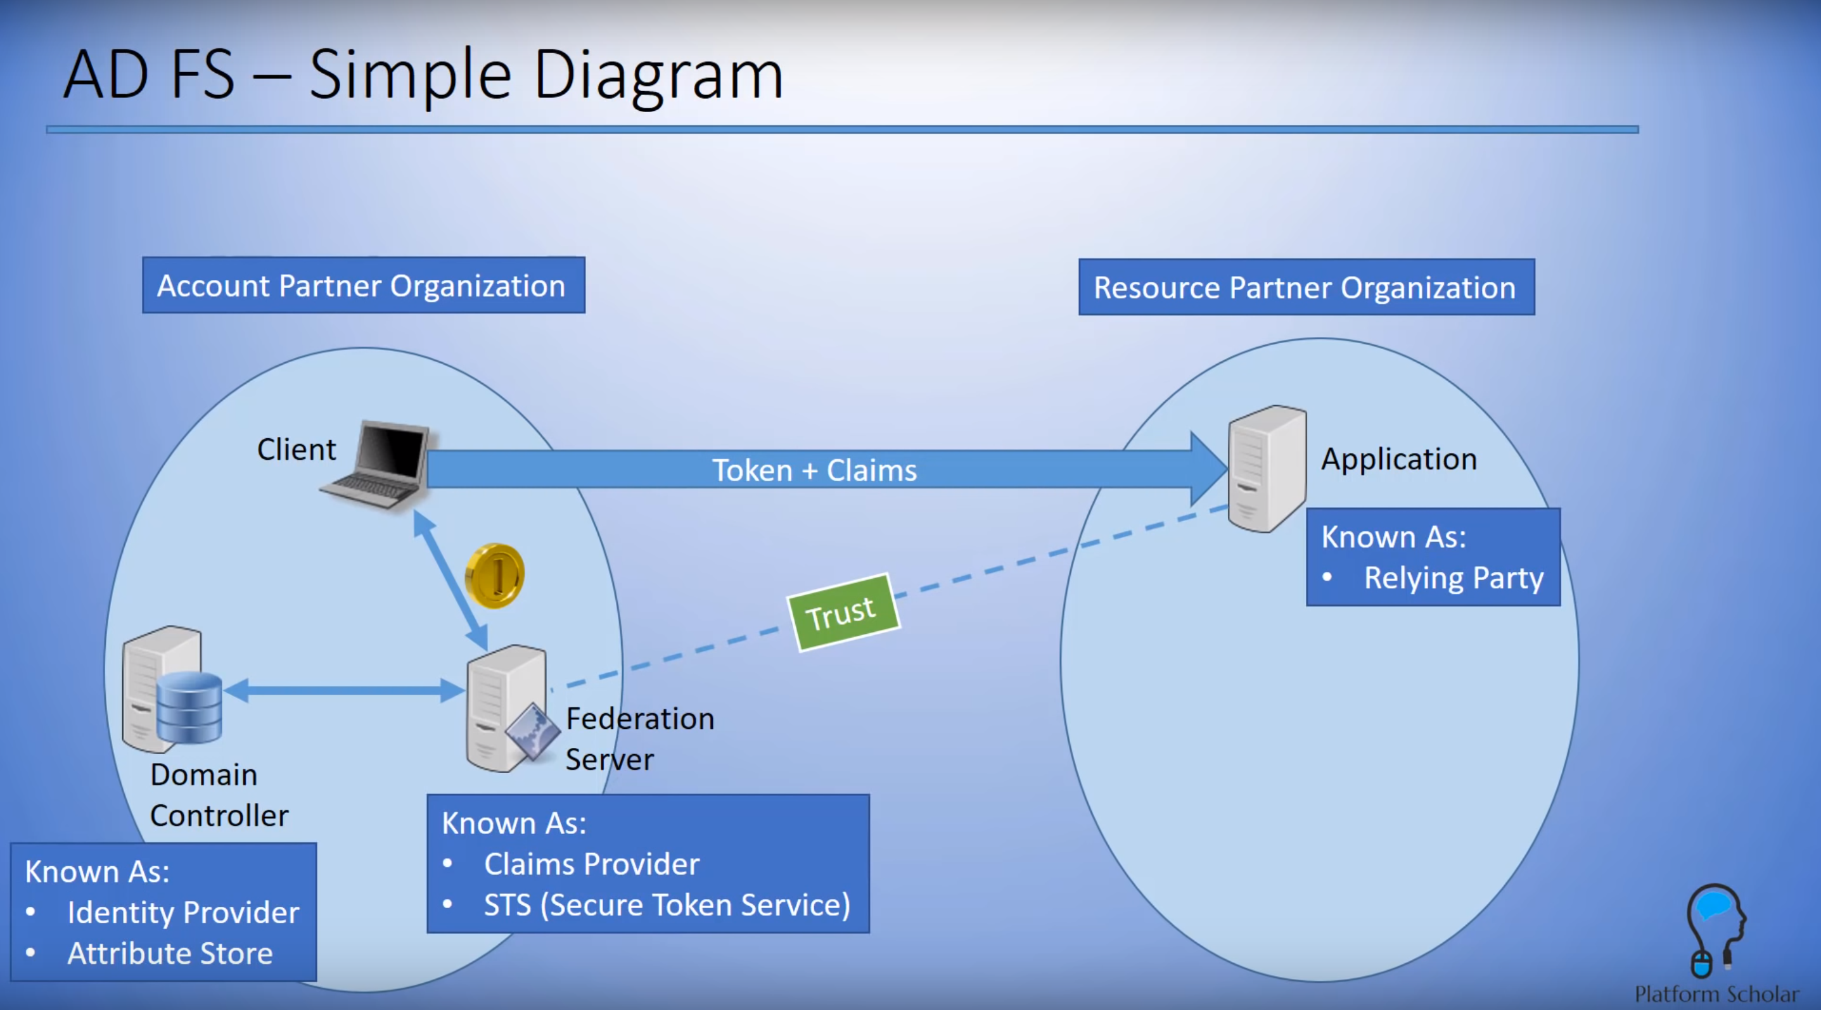
Federated identities (2)
Notes:
https://www.youtube.com/watch?v=ireTh8eFTkM

Slide 11

Authentication options
Cloud-only authentication
Synchronized identity authentication
Federated identity authentication
Azure AD
Azure AD
Azure AD
Azure AD Connect and password sync
Azure AD
Connect
Federation
AD DS
AD DS
Independent cloud identity
Single identity, enabling a same sign-on experience with password hash synchronization
Single federated identity, enabling SSO in some scenarios and additional flexibility

Slide 12
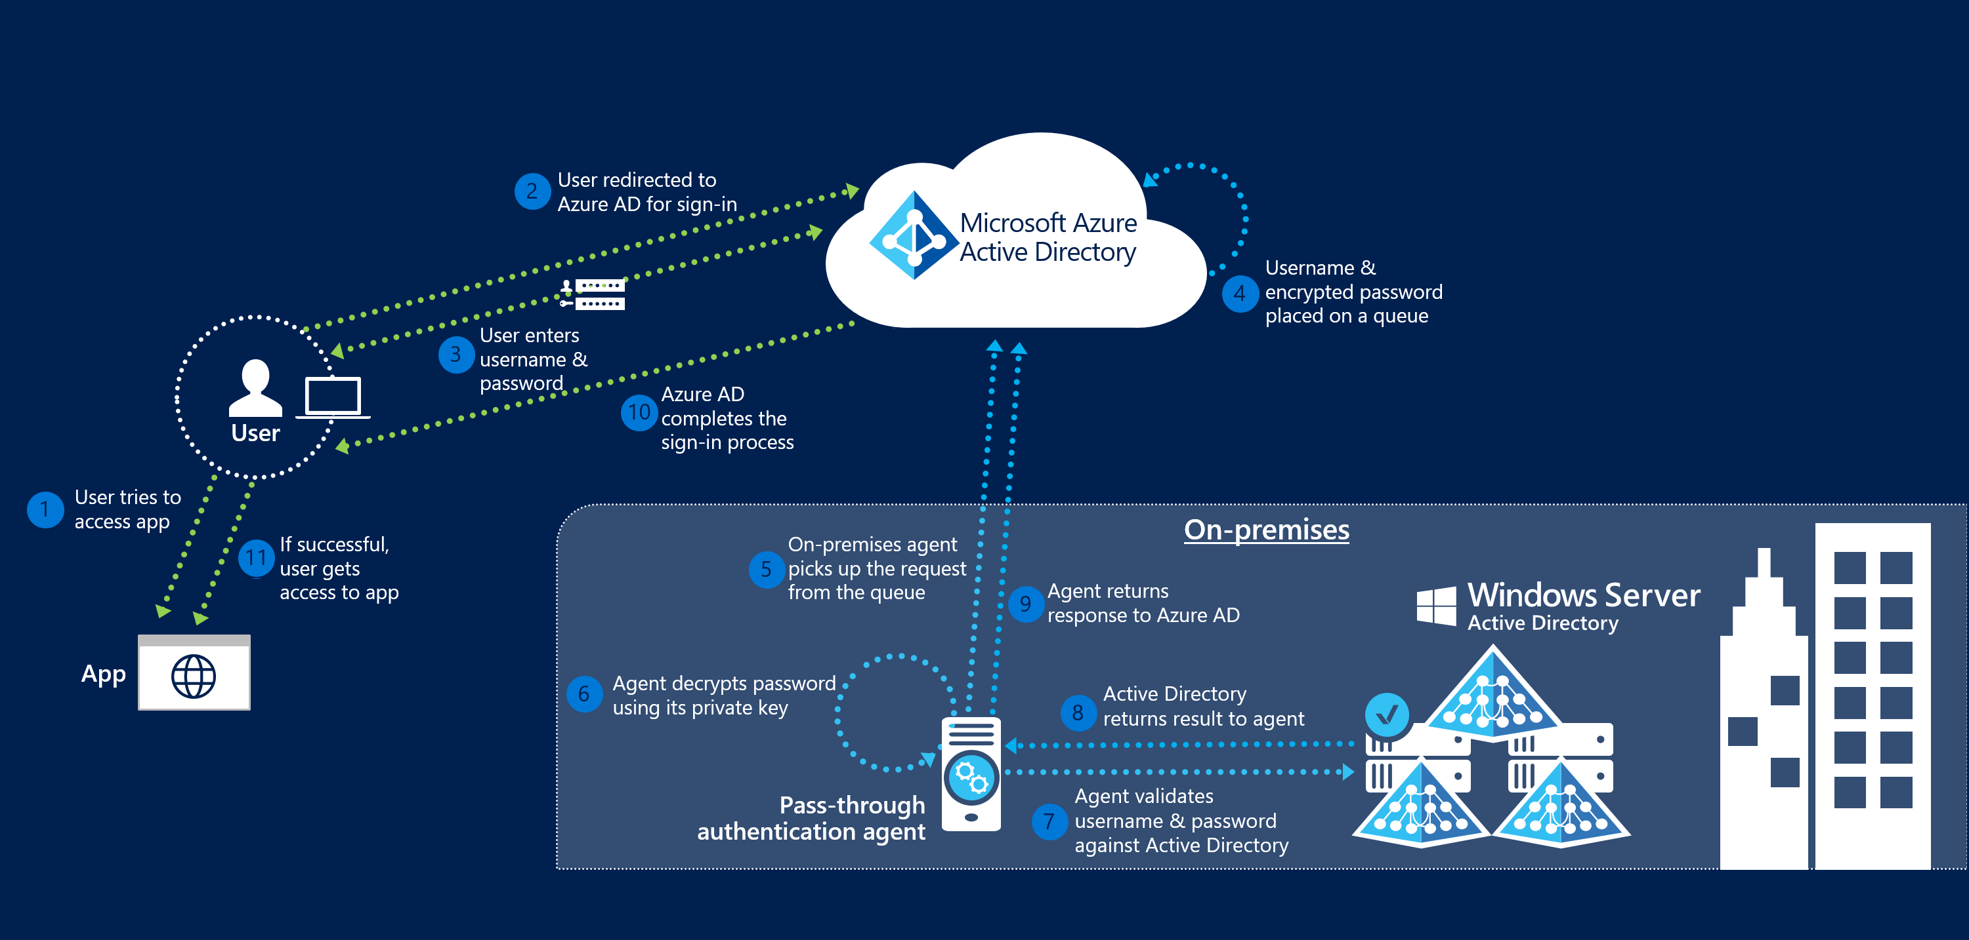
Azure AD pass-through authentication (PTA)

Slide 13
User Principal Name (UPN)
The [unique] logon name of the user
Example: Ivan.Petrov@softuni.bg
It should map to the user email address
Default domain for new subscriptions is: tenantname.onmicrosoft.com
…meaning that the default UPN of the users is like this:
Ivan.Petrov@softunibg.onmicrosoft.com

Slide 14
Groups
For better organization and security, we can use groups
Then we make users members of a given group
Group types can be:
Security group (used for granting access to Office 365 resources, may contain users or devices, may have dynamic membership)
Distribution list (used for sending emails to a group of people)
Mail-enabled security group (cannot contain devices, does not provide dynamic membership)
Office 365 group (can be used for resource access and email, mainly used for collaboration)
Shared mailboxes

Slide 15
Windows AD vs Azure AD
Azure AD is not “another Windows AD, but in the cloud”
Azure AD is very similar to AD DS (Active Directory Domain Services), but there are differences:
No group policies and no structuring in the form of OUs (Organizational Unites) in Azure AD
Authentication is different - AD DS uses Kerberos, while Azure AD uses protocols over HTTP(S) - SAML, OAuth (for authorization)
AD DS uses LDAP for queries, Azure AD uses REST API over HTTPS

Slide 16
Questions
sli.do # SaaS-Security

Slide 17
Security considerations and mechanisms to protect

Slide 18
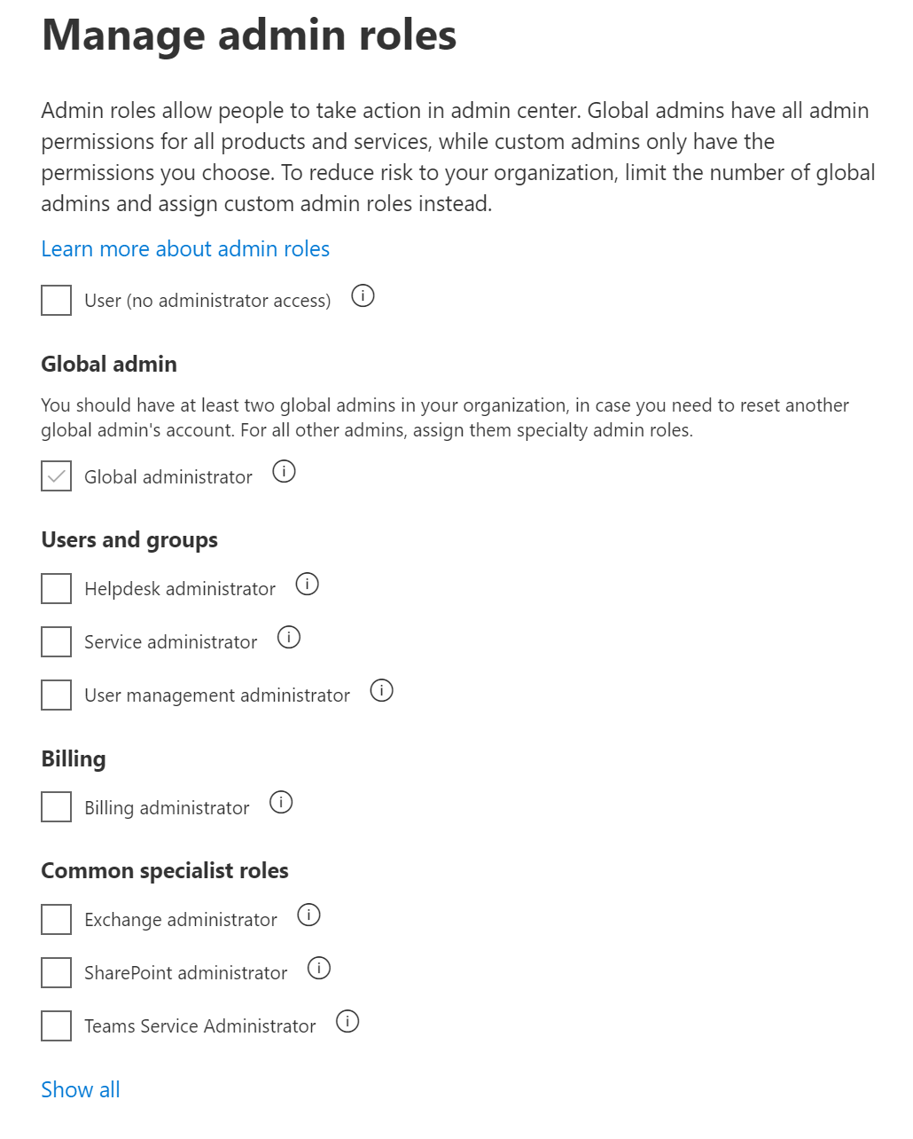
User account roles
Each account in Office 365 can be either with a “user” role or some type of admin:
Global administrator
User management administrator
Service administrator
Exchange administrator
SharePoint administrator
etc.
A user can be with an admin role and without any license

Slide 19
User account protection
User account attacks are widespread, dangerous and hard to detect
Protection
Passwords and password policies
Multi-factor authentication
Conditional access
Secure score

Slide 20
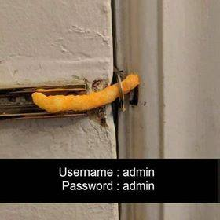
Passwords and password policies
Password policies for synced (from local AD) accounts:
Password complexity policy (the on-premise instance settings applied)
Password expiration policy (the cloud password is set to “never expire”)
Password policies for cloud-only accounts
Password complexity policy (default settings, cannot be modified)
Password expiration policy (configurable in the portal)

Slide 21
Reset passwords for users and admins
Who can reset users’ passwords?
Global administrator or a custom “password” administrator
Users can reset their own passwords (SSPR) - must be enabled (if the user is synced, Azure AD Premium plan is required)
Who can reset administrators’ passwords?
Another Office 365 administrator
Administrators can reset their own passwords (SSPR) - enabled by default (if the user is synced, Azure AD Premium plan is required)

Slide 22
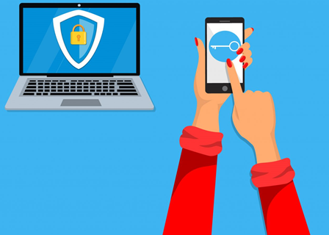
Multi-factor authentication (MFA)
MFA requires more than one verification method
Adds a second layer of security
For cloud-only identities, the second factor can be:
Authentication phone (SMS)
Mobile app (notifications or verification code) - preferred method

Slide 23
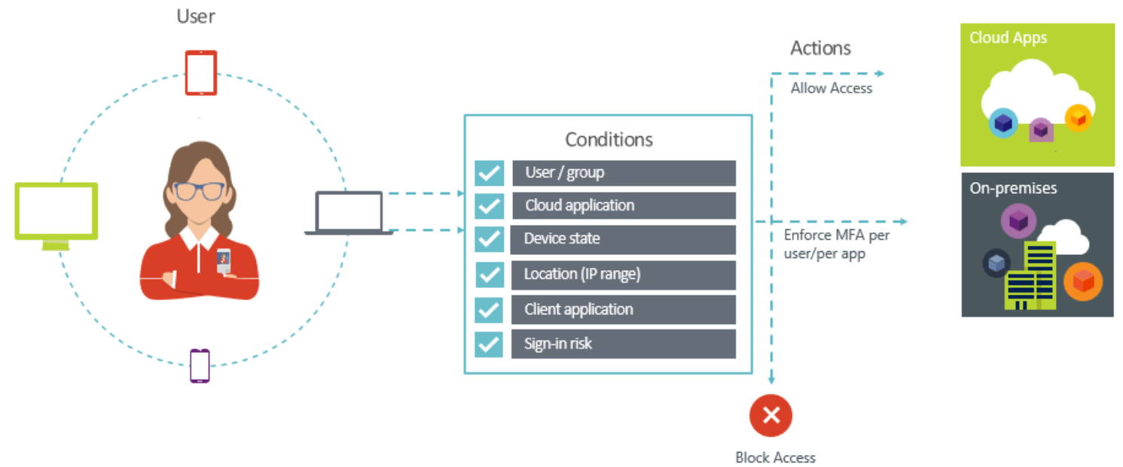
Conditional access
Automated access control decisions
Not just who, but how a resource is accessed matters
It is a feature of Azure AD

Slide 24
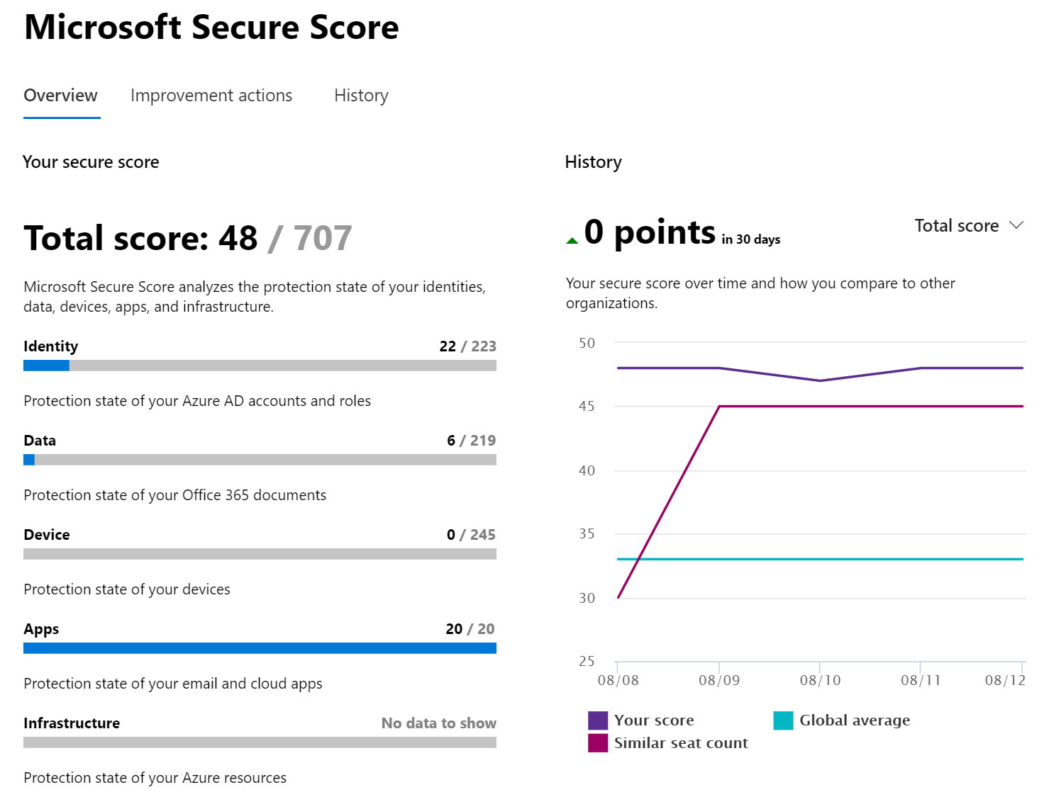
Secure score
Visualizes the security level of your tenant
Compares with other companies with similar seat count
Compares with the “global average”
Gives improvement actions to increase your score

Slide 25
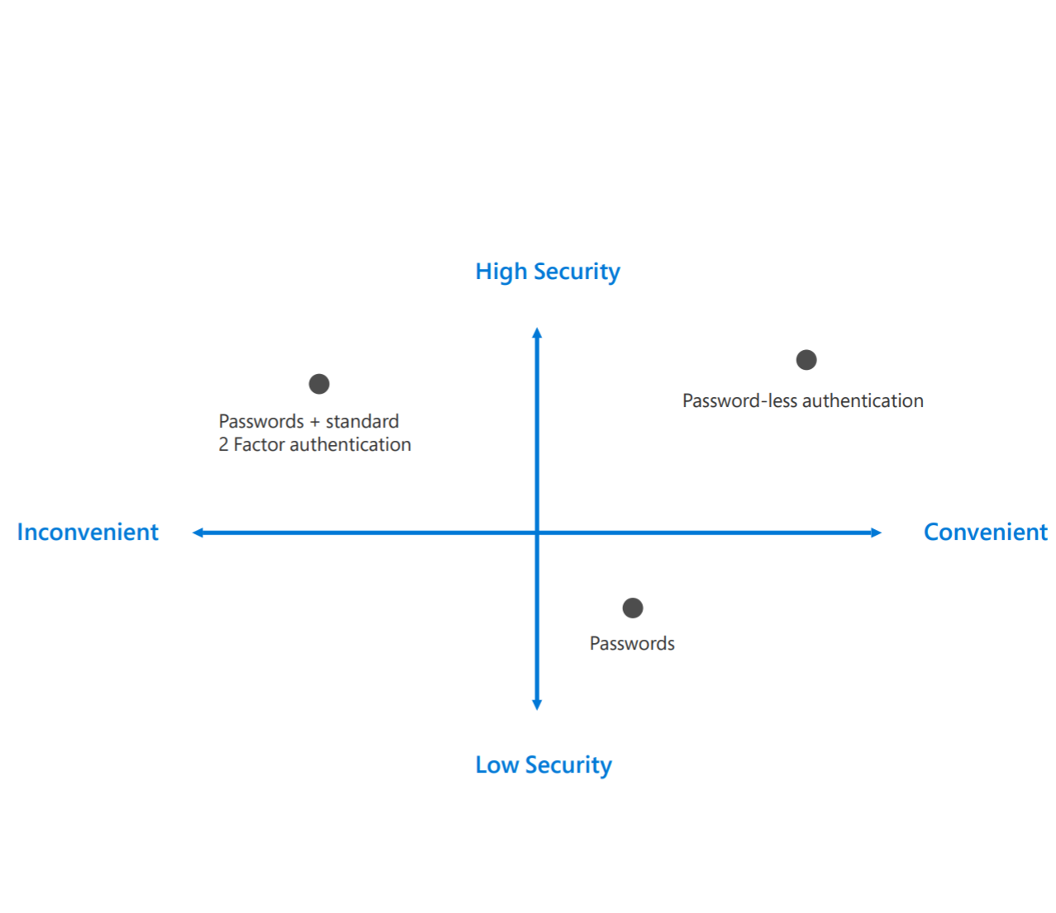
The end of passwords
Passwords are no longer enough
How to go password-less?
Windows HELLO for Business (biometric or PIN)
FIDO2 support for password-less sign-in
Microsoft Authentication app
User adoption – educate your employees
Notes:
https://www.microsoft.com/en-us/security/technology/identity-access-management/passwordless

Slide 26
Questions
sli.do # SaaS-Security

Slide 27
Creating identities in the cloud

Slide 28
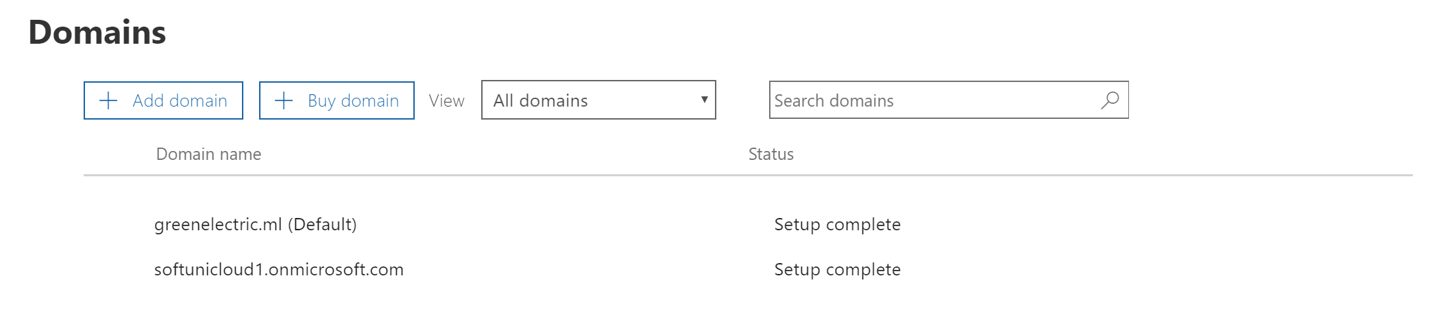
Add a custom domain
Remember the [ugly] something.onmicrosoft.com domain?
In order to have users in the format ivan.petrov@mydomain.com, we need to add mydomain.com in our tenant
To do it, we need to prove the ownership (by adding a DNS record)
Optionally, we can transfer the DNS management inside Office 365
Custom domain
Initial domain

Slide 29
Options to create identities
To create identities in the cloud, several options exist:
From the Microsoft 365 admin center
Using PowerShell
Import from file
Using directory synchronization (Azure AD connect)

Slide 30
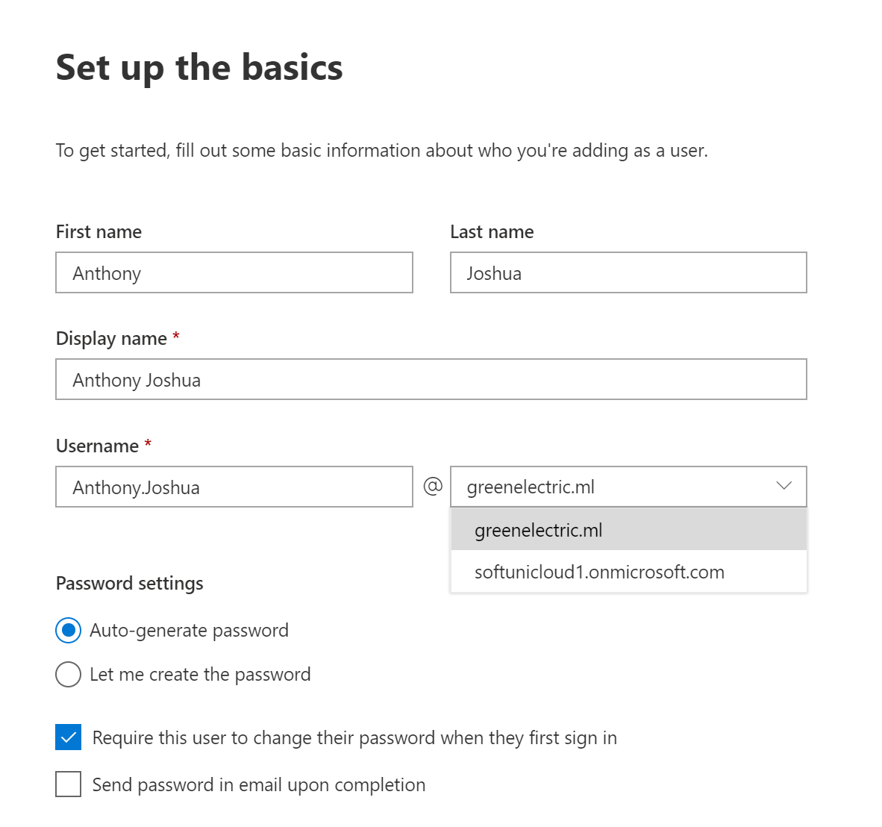
Create identities from the admin center
When creating users in the portal, you specify:
Names and UPN
Determine the password
Assign licenses
User/admin roles
Profile info (department, phone numbers, address, etc.)

Slide 31
Create identities using PowerShell
Connect to your Office 365 tenant
If using the Microsoft Azure Active Directory Module for Windows PowerShell, issue the command:
New-MsolUser -DisplayName <display name> -FirstName <first name> -LastName <last name> -UserPrincipalName <sign-in name> -UsageLocation <ISO 3166-1 alpha-2 country code> -LicenseAssignment <licensing plan name> [-Password <Password>]

Slide 32
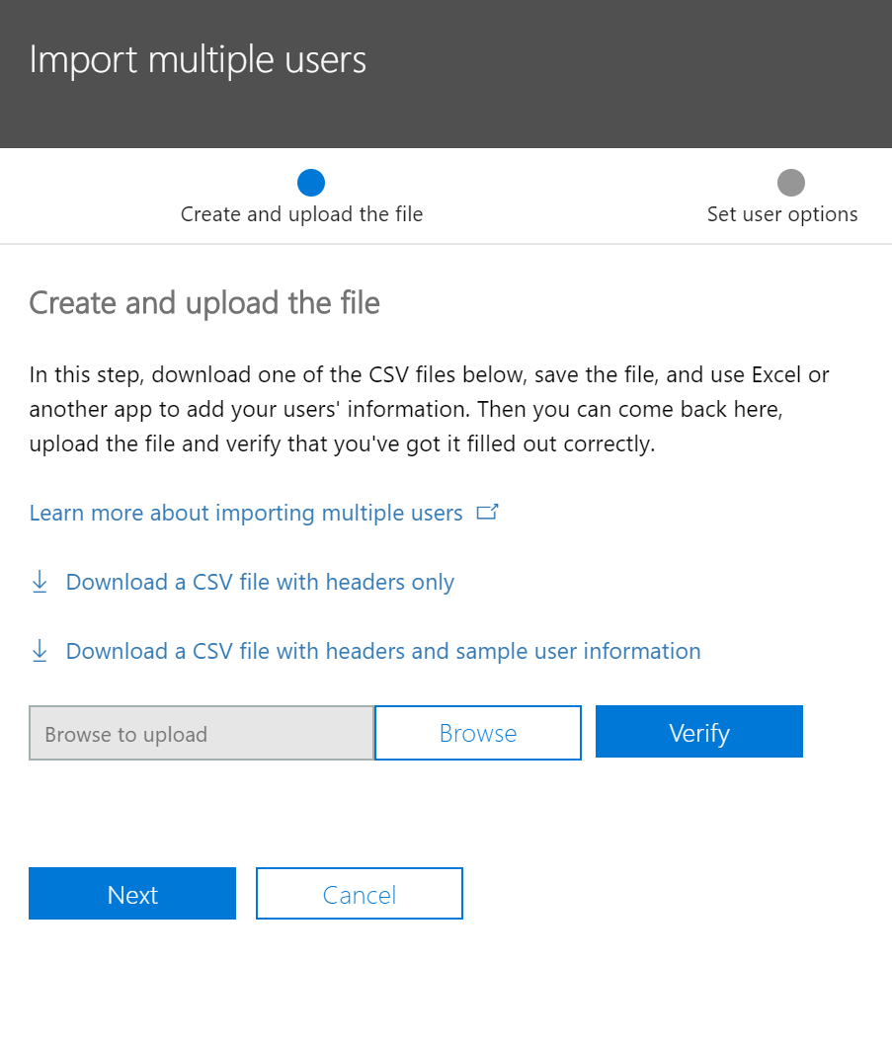
Import users from file
Office 365 gives options for bulk import
CSV file containing user information needs to be uploaded
Easy to use – just download the sample CSV and modify it

Slide 33
Directory synchronization (Azure AD connect)
The accounts are first created in the local AD and then synced
The synced identities are read-only in the Office 365 portal
Synchronization is usually one-way (with some exceptions)

Slide 34
Deleting and recovering user accounts
Carefully plan what and how you are going to delete
The user’s content is typically kept (and recoverable) for 30 days after deletion
The user’s license will be available for other users after deletion
You can restore the user’s account (and data) within 30 days if the user is in the recycle bin (deleted users)
You can permanently delete a user account with PowerShell

Slide 35
Questions
sli.do # SaaS-Security

Slide 36
Demonstration

Slide 37
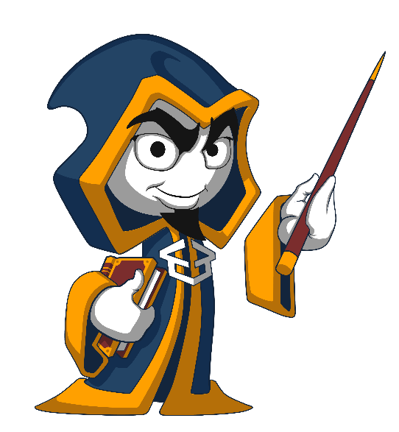
Summary
General principles
Security considerations and mechanisms to protect
Creating identities in the cloud
Demonstration
…
…
…

Slide 39
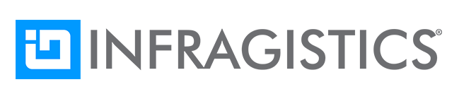
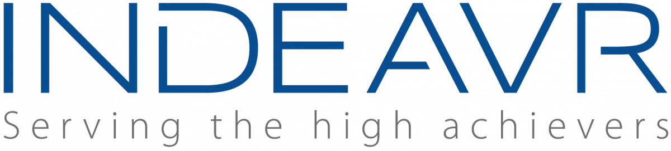

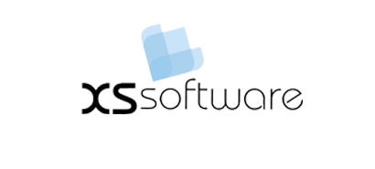


СофтУни диамантени партньори

Slide 40

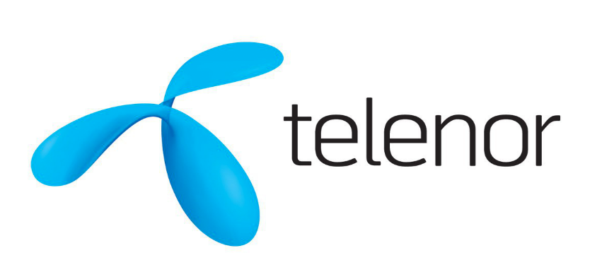




СофтУни диамантени партньори

Slide 41





Trainings @ Software University (SoftUni)
Software University – High-Quality Education, Profession and Job for Software Developers
softuni.bg
Software University Foundation
http://softuni.foundation/
Software University @ Facebook
facebook.com/SoftwareUniversity
Software University Forums
forum.softuni.bg

